Slide 1
Metagonimus yokogawii:
in fish eating mammals in Asia; utilizes freshwater trout, other salmonids, and cyprinids, for second intermediate hosts. The adult which measured 1-2.5 X 0.4-0.7 millimeter, the whole body is covered with spiny cuticle, ventral sucker at right side of the body. Egg with operculum and miracidum inside egg shell measured 27-30 X 15-17 µm, the figure of this parasite collected from dog's intestine from Basrah city/ southern Iraq in 2004 by Prof. Dr. Suzan Al-Azizz as a first record in Iraq and Basrah city.

Slide 2
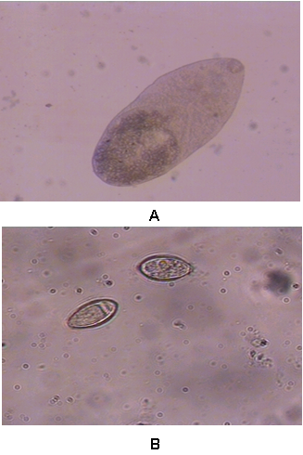


Slide 3



Slide 4
THANK YOU

